Slide 1
3.7 Sequential Circuits (1 of 30)
Combinational logic circuits are perfect for situations when we require the immediate application of a Boolean function to a set of inputs.
There are other times, however, when we need a circuit to change its value with consideration to its current state as well as its inputs.
These circuits have to “remember” their current state.
Sequential logic circuits provide this functionality for us.

Slide 2
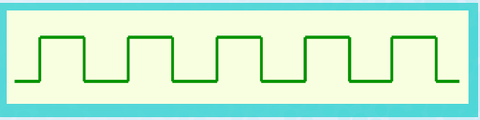
3.7 Sequential Circuits (2 of 30)
As the name implies, sequential logic circuits require a means by which events can be sequenced.
State changes are controlled by clocks.
A “clock” is a special circuit that sends electrical pulses through a circuit.
Clocks produce electrical waveforms such as the one shown below.

Slide 3
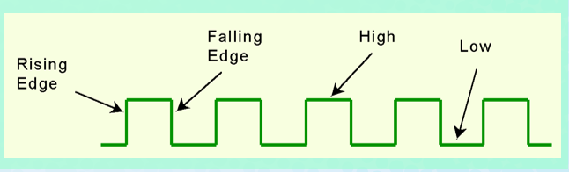
3.7 Sequential Circuits (3 of 30)
State changes occur in sequential circuits only when the clock ticks.
Circuits can change state on the rising edge, falling edge, or when the clock pulse reaches its highest voltage.

Slide 4
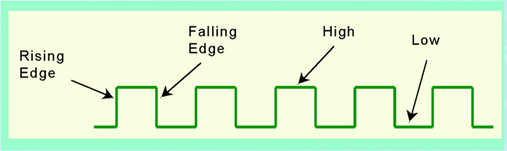
3.7 Sequential Circuits (4 of 30)
Circuits that change state on the rising edge, or falling edge of the clock pulse are called edge-triggered.
Level-triggered circuits change state when the clock voltage reaches its highest or lowest level.

Slide 5
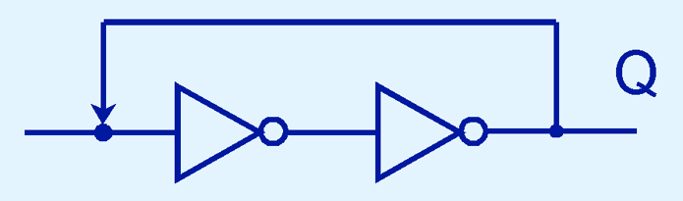
3.7 Sequential Circuits (5 of 30)
To retain their state values, sequential circuits rely on feedback.
Feedback in digital circuits occurs when an output is looped back to the input.
A simple example of this concept is shown below.
If Q is 0 it will always be 0, if it is 1, it will always be 1. Why?

Slide 6
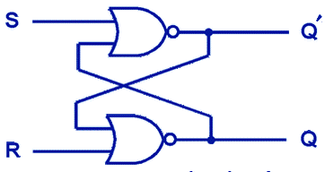
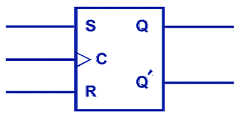
3.7 Sequential Circuits (6 of 30)
You can see how feedback works by examining the most basic sequential logic components, the SR flip-flop.
The “SR” stands for set/reset.
The internals of an SR flip-flop are shown below, along with its block diagram.

Slide 7

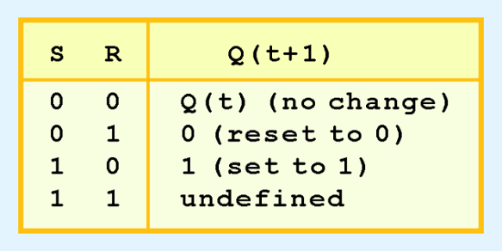
3.7 Sequential Circuits (7 of 30)
The behavior of an SR flip-flop is described by a characteristic table.
Q(t) means the value of the output at time t. Q(t+1) is the value of Q after the next clock pulse.

Slide 8

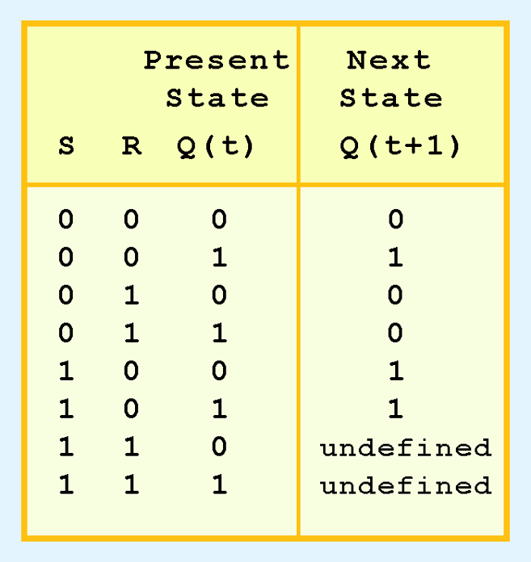
3.7 Sequential Circuits (8 of 30)
The SR flip-flop actually has three inputs: S, R, and its current output, Q.
Thus, we can construct a truth table for this circuit, as shown at the right.
Notice the two undefined values. When both S and R are 1, the SR flip-flop is unstable.

Slide 9
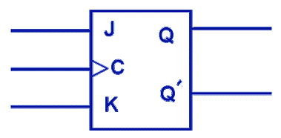
3.7 Sequential Circuits (9 of 30)
If we can be sure that the inputs to an SR flip-flop will never both be 1, we will never have an unstable circuit. This may not always be the case.
The SR flip-flop can be modified to provide a stable state when both inputs are 1.
This modified flip-flop is called a JK flip-flop, shown at the right.

Slide 10
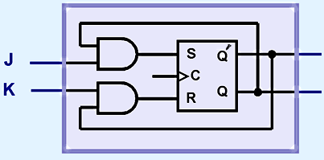
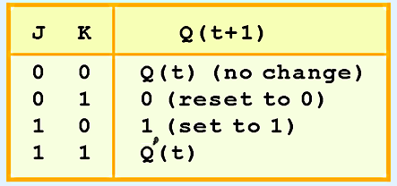
3.7 Sequential Circuits (10 of 30)
At the right, we see how an SR flip-flop can be modified to create a JK flip-flop.
The characteristic table indicates that the flip-flop is stable for all inputs.
‘

Slide 11
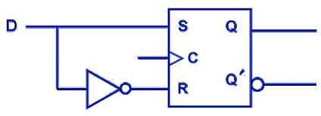
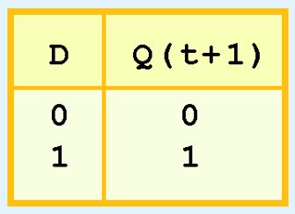
3.7 Sequential Circuits (11 of 30)
Another modification of the SR flip-flop is the D flip-flop, shown below with its characteristic table.
You will notice that the output of the flip-flop remains the same during subsequent clock pulses. The output changes only when the value of D changes.

Slide 12
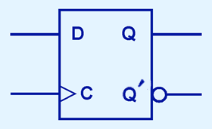


3.7 Sequential Circuits (12 of 30)
The D flip-flop is the fundamental circuit of computer memory.
D flip-flops are usually illustrated using the block diagram shown below.
The characteristic table for the D flip-flop is shown at the right.

Slide 13
3.7 Sequential Circuits (13 of 30)
The behavior of sequential circuits can be expressed using characteristic tables or finite state machines (FSMs).
FSMs consist of a set of nodes that hold the states of the machine and a set of arcs that connect the states.
Moore and Mealy machines are two types of FSMs that are equivalent.
They differ only in how they express the outputs of the machine.
Moore machines place outputs on each node, while Mealy machines present their outputs on the transitions.

Slide 14
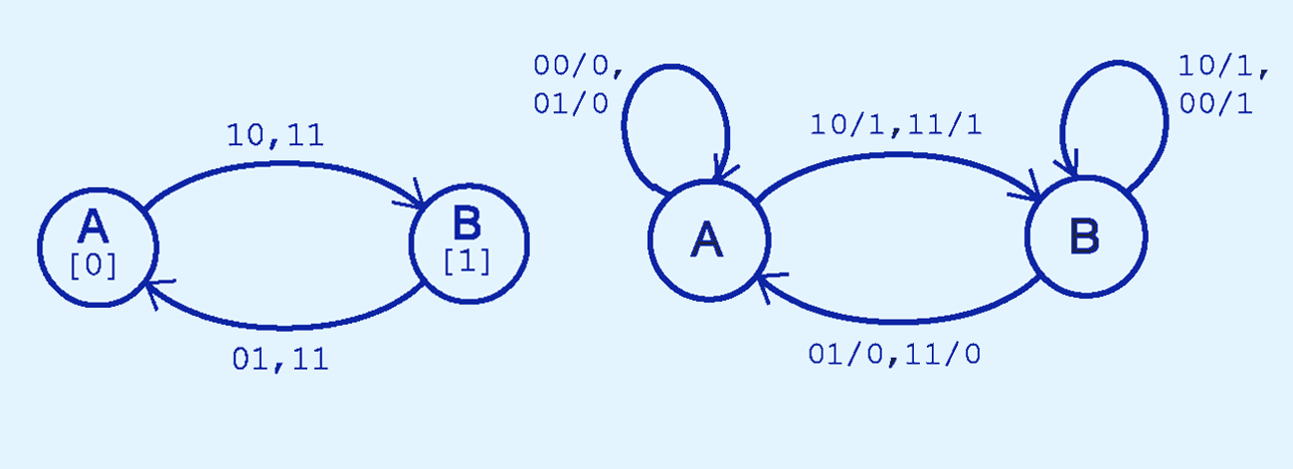
3.7 Sequential Circuits (14 of 30)
The behavior of a JK flop-flop is depicted below by a Moore machine (left) and a Mealy machine (right).

Slide 15
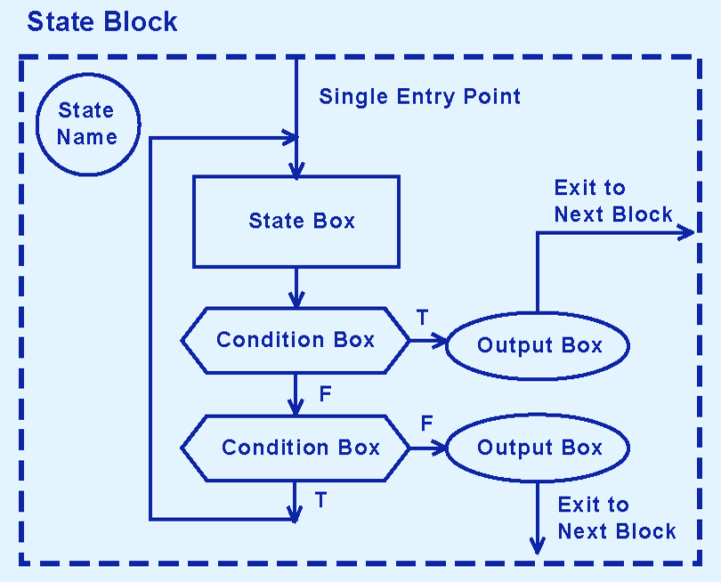
3.7 Sequential Circuits (18 of 30)

Slide 16
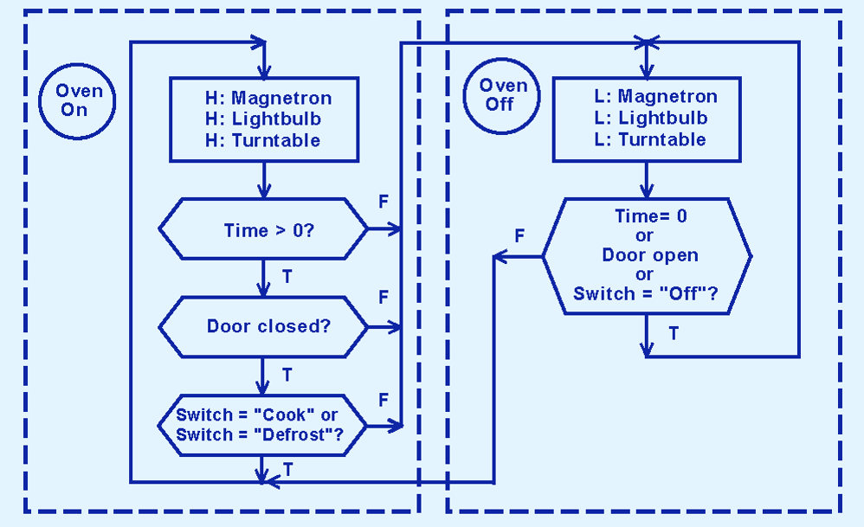
3.7 Sequential Circuits (19 of 30)
This is an ASM for a microwave oven.

Slide 17
3.7 Sequential Circuits (20 of 30)
Sequential circuits are used anytime that we have a “stateful” application.
A stateful application is one where the next state of the machine depends on the current state of the machine and the input.
A stateful application requires both combinational and sequential logic.
The following slide provide an example of a circuit that falls into this category.

Slide 18
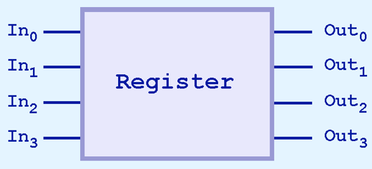
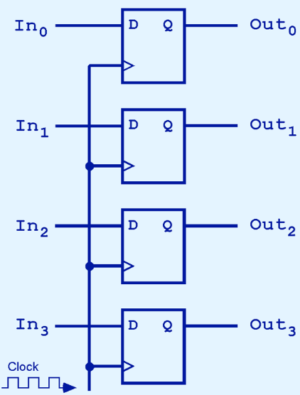
3.7 Sequential Circuits (21 of 30)
This illustration shows a 4-bit register consisting of D flip-flops. You will usually see its block diagram (above) instead.

Slide 19
Conclusion (1 of 3)
Computers are implementations of Boolean logic.
Boolean functions are completely described by truth tables.
Logic gates are small circuits that implement Boolean operators.
The basic gates are AND, OR, and NOT.
The “universal gates” are NOR, and NAND.

Slide 20
Conclusion (2 of 3)
Computer circuits consist of combinational logic circuits and sequential logic circuits.
Combinational circuits produce outputs (almost) immediately when their inputs change.
Sequential circuits require clocks to control their changes of state.
The basic sequential circuit unit is the flip-flop: The behaviors of the SR, JK, and D flip-flops are the most important to know.

Slide 21
Conclusion (3 of 3)
The behavior of sequential circuits can be expressed using characteristic tables or through various finite state machines.
Moore and Mealy machines are two finite state machines that model high-level circuit behavior.
Algorithmic state machines are are also used for expressing timing and complex signal interactions.
One example of a sequential circuit is the register.

